Slide 1

Adding a Little DAPR to Your .NET Microservices
Cecil Phillip
Senior Cloud Developer Advocate
@cecilphillip

Slide 2
What is holding microservice development back?
Hard to incrementally migrate from existing code to a microservices architecture
Programming model runtimes have narrow language support and tightly controlled feature sets
Runtimes only target specific infrastructure platforms with limited code portability across clouds and edge

Slide 3
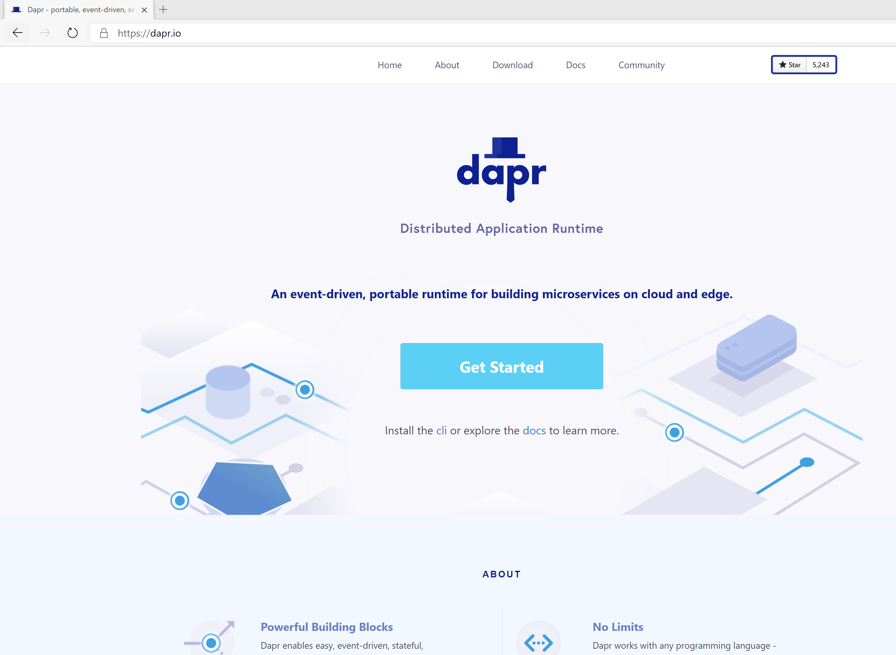
Distributed Application Runtime
Portable, event-driven, runtime for building distributed applications across cloud and edge
https://dapr.io

Slide 4

Dapr Goals
Best-practices building blocks
Any language or framework
Consistent, portable, open APIs
Adopt standards
Extensible and pluggable components
Platform agnostic cloud + edge
Community driven vendor neutral

Slide 5

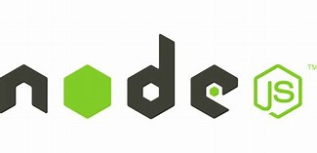



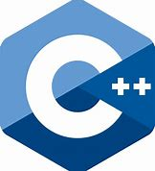
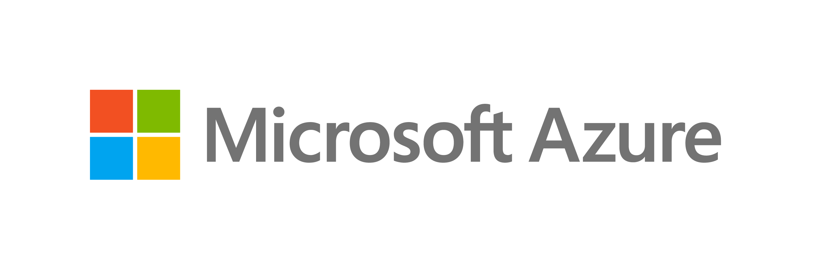

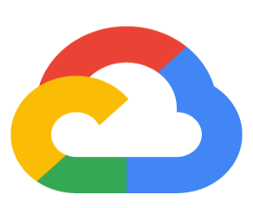




Dapr: Distributed Application Runtime Build apps using any language with any framework
Application code
Microservices written in
Any code or framework…
HTTP API
gRPC API
Service-to- service invocation
State management
Publish and subscribe
Resource bindings and triggers
Actors
Distributed tracing
Secrets
Extensible
Any cloud or edge infrastructure

Slide 6








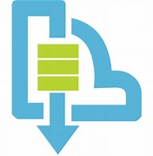
Sidecar and component architecture
Resource bindings
…others
Scanning for events
Input/output
EventHub
Kafka
AWS SQS
GCP pub/sub
Application
Secure communication with mTLS
Service
code A
Service
code B
Dapr API
Dapr API
Tracing, logs
and metrics
Tracing, logs
and metrics
Sidecar
Sidecar
Load and
save state
State stores
…others
AWS DynamoDB
CosmosDB
Publish & subscribe
Messaging
…others
Service Bus

Slide 7




Dapr Kubernetes hosted
Deploys and manages Dapr
1
Components
Updates actor partition placement
Certificate Authority
Update component changes
Resource bindings
Pod
Pod
Pod
Pod
Input/output
CONTAINER
CONTAINER
CONTAINER
CONTAINER
…others
Component management
EventHub
Kafka
AWS SQS
GCP pub/sub
Actor Placement
Sidecar Injector
Sentry
Operator
State stores
Injects Dapr runtime
AWS
DynamoDB
CosmosDB
…others
Pod
CONTAINER
Dapr API
CONTAINER
Publish & subscribe
HTTP or gRPC
…others
Sidecar
Application code
Service Bus
Distributed Tracing
Uses components
Any cloud or edge infrastructure
Prometheus
AppInsightts
Jaeger

Slide 8
Microservice building blocks
Service-to- service invocation
State management
Publish and subscribe
Resource bindings and triggers
Actors
Distributed tracing
Secrets
Perform direct, secure, service-to-service method calls
Create long running, stateless and stateful services
Secure, scalable messaging between services
Trigger code through events from a large array of inputs
Output bindings to external resources including databases and queues
Encapsulate code and data in reusable actor objects as a common microservices design pattern
See and measure the message calls across components and networked services
Securely access secrets from your application
Use Dapr components

Slide 9
Microservice building blocks
Service invocation
Post
http://localhost:3500/v1.0/invoke/cart/method/checkout
{
"user":"johndoe",
"cart":"0001"
}
“frontend”
Post
http://10.0.0.2:8000/checkout
{
"user":"johndoe",
"cart":"0001"
}
“cart”

Slide 10
Microservice building blocks
State management: key/value
Get
http://localhost:3500/v1.0/state/<store-name>/planet
{
"name": "Tatooine"
}
App
“myApp”
key | value
myApp-weapon | "DeathStar"
myApp-planet | { "name": "Tatooine" }
Post
http://localhost:3500/v1.0/state/<store-name>
[{
"key": "weapon",
"value": "DeathStar"
}, {
"key": "planet",
"value": {
"name": "Tatooine"
}
}]
State store of your choice
AWS
DynamoDB
CosmosDB
…others

Slide 11
DEMO: Dapr state management and bindings
DEMO
Dapr state management
components

Slide 12
Microservice building blocks
Publish and subscribe
Publish
Subscribe
“cart”
“shipping”
Post
http://10.0.0.5:8005/order
Post
http://localhost:3500/v1.0/publish/
"data":{
"user":"johndoe",
"item":"ZeroDay"
}
"topic":"order",
"data":{
"user":"johndoe",
"item":"ZeroDay"
},
Post
http://10.0.0.4:8004/order
“email”

Slide 13
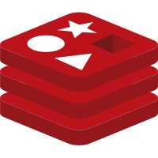

Microservice building blocks
Resource triggers: Input
Get / Post
http://localhost:8000/trigger
Redis
{
"user":"johndoe"
}
App
Event Hubs
Redis
SQS
Event Hubs
Kafka
Kafka
SQS

Slide 14



Microservice building blocks
Resource bindings: Output
Redis
Event Hubs
App
“myApp”
DynamoDB
Redis
Event Hubs
CosmosDB
Kafka
Twilio
DynamoDB
Post
http://localhost:3500/v1.0/bindings/myDatabase
CosmosDB
{
"data":
{
"sku":"v100",
"quantity":"50"
}
}
Kafka
Twilio

Slide 15
DEMO
Dapr Publish and Subscribe

Slide 16





Cloud Secret Stores
Microservice building blocks
Secrets
Google
Key Management
Azure
Key Vault
Application
code
GET
http://localhost:3500/v1.0/secrets/vault/mysecret
mysecret “supersecret”

Slide 17
Microservice building blocks
Secrets with Azure Kubernetes Service
Azure
Key Vault
1
Pod
Application
code
GET
http://localhost:3500/v1.0/secrets/vault/mysecret
mysecret “supersecret”
Pod
Managed Identity

Slide 18
Microservice building blocks
Secrets with Kubernetes
1
Pod
Application
code
GET
http://localhost:3500/v1.0/secrets/kubernetes/mysecret
mysecret “supersecret”
Kubernetes
Secret Store

Slide 19
DEMO
Dapr Secrets

Slide 20
Dapr language SDKs
Distributed Application Runtime Build apps using any language with any framework
Application code
Microservices written in
Any code or framework…
HTTP API
gRPC API
Service-to- service invocation
State management
Publish and subscribe
Resource bindings and triggers
Actors
Distributed tracing
Secrets
Extensible
Any cloud or edge infrastructure

Slide 21




Integration with developer frameworks
Application code
Microservices written in
Any code or framework…
Virtual
Actors
ASP.NET Core
Functions
Logic Apps
Spring Boot
Server Side
Blazor
HTTP API
gRPC API
Service-to- service invocation
State management
Publish and subscribe
Resource bindings and triggers
Actors
Distributed tracing
Secrets
Extensible
Any cloud or edge infrastructure

Slide 22
Dapr and Azure Functions
Building an Azure Functions Dapr extension
Enables an Azure Function to interact seamlessly with Dapr capabilities in Kubernetes, IoT Edge and other hosting platforms

Slide 23


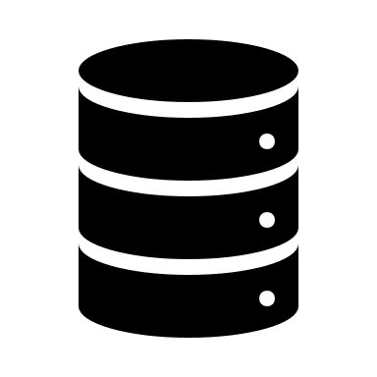
Dapr Workflows Activate Logic Apps workflows from Dapr
Workflows
Sidecar
Input Bindings
EventHub
Kafka
AWS SQS
gRPC server
gRPC
dapr client
App
Logic Apps Runtime
gRPC/
HTTP
workflow.json
Post
http://localhost:3500/v1.0/invoke/workflows/method/my-workflow
Volume Mount

Slide 24
Virtual Actors with Dapr
Stateful, objects of storage and compute
Dapr Actor features:
Distribution and failover
Turn-based concurrency
State management
Timers
Reminders
Host/Pod
Video Game Enemy
X pos
Y pos
Z pos
Difficulty
Spawn( )
Host/Pod
Weapons
Attack( )
Virtually identical to Service Fabric Reliable Actors

Slide 25
Roadmap
Dapr v1.0 runtime
Azure Functions extension v1.0
Combine Dapr and Functions on Kubernetes and IoT Edge
Logic App workflows v1.0
Build event driven workflow apps on Kubernetes and IoT Edge
Logic App workflows v1.0
Use Self-hosted APIM as an ingress gateway to invoke services and send events
Dapr in Azure Managed Services
Integrated into AppService, Azure Functions, AKS
Notes:
•Dapr [v1.0] release
•Dapr & Azure Functions extension [v1.0]
Enables developers to combine Dapr and Functions on Kubernetes and IoT Edge
•Dapr & Logic App workflows [v1.0]
Enables enterprise developers to build event driven, workflow apps on Kubernetes and IoT Edge
•APIM & Dapr integration [preview]
Enables developers to use Self-hosted APIM as an ingress gateway to invoke services and send events

Slide 26
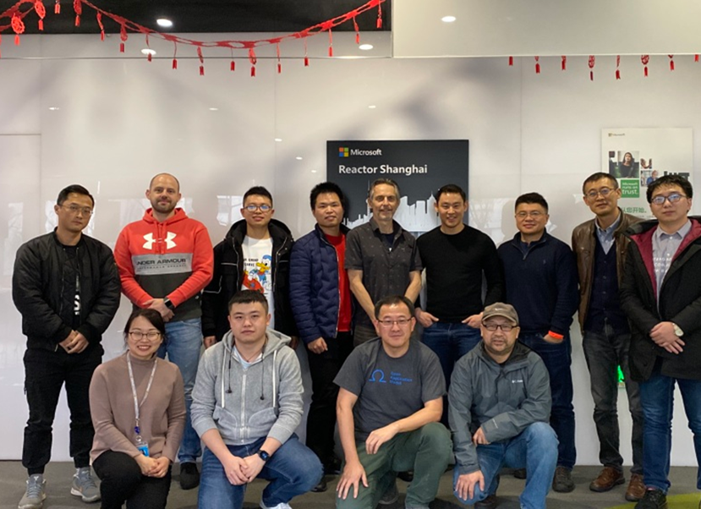
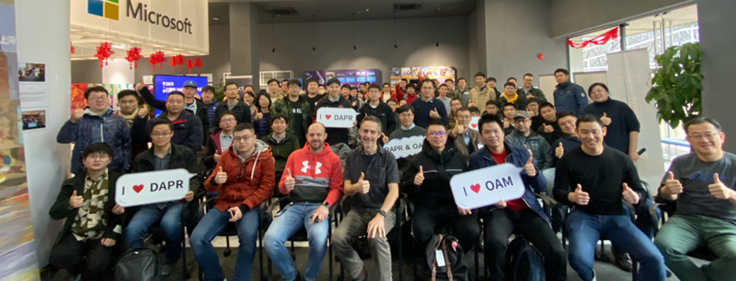

Get involved
1
https://www.theurlist.com/dotnet-dapr

